Slide 1
Data Analytics and Visualization for Digital Forensics
Module 3, Day 4
Dr.ir. Hans Henseler,
University of Applied Sciences Leiden (NL)
Master of Advanced Studies in Digital Forensics & Cyber Investigation
Bern University of Applied Sciences

Slide 2
Module 3: Data Analytics and Visualization
This module teaches the use of data analytics and visualization for digital forensics. Topics covered include:
Log analysis and correlation
Event reconstruction using timelines
Using Plaso to create super-timelines
Working with Big Data repositories
Correlation and relationship analysis
Statistical analysis
Advanced search techniques

Slide 3
Day 4
Day 4 | Email Data visualization and full-text search
08:30 | Part 7: Email data in digital forensics
 | Filtering, analyzing and visualizing email data
10:30 | Exercise 7: Plot emails on a timeline and visualize email network
12:00 | Lunch
13:00 | Part 8: Advanced Full-text search strategies
14:00 | Student project part 2/2: finish your project
 | Q&A while doing your project
16:30 | End of the day (no review)

Slide 4
Day 4: Learning Goals
Filtering and visualizing email data
Use a heatmap to visualize email traffic density
Basics of social network (relationship) analysis
visualizing a graph network in Python
Full-text search strategies
Combining full-text search with facet search
Understand recall and precision

Slide 5
Part 7: Email data in digital forensics. Filtering, analyzing and visualizing email data

Slide 6
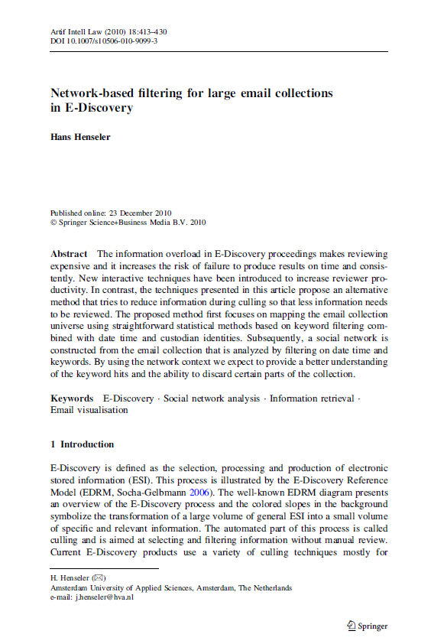
analyzing and visualizing emails
Presentation is based on publication: Henseler, J. “Network-based filtering for large email collections in E-Discovery”
Published in 2010 in Artificial Intelligence and Law volume 18, pages 413–430 (2010)
PDF in the Testdata folder as “2010 Henseler_Network-based_filtering.pdf”, or
https://link.springer.com/article/10.1007%2Fs10506-010-9099-3
Based on the DESI III workshop that was held as part of the ICAIL 2009 conference in Barcelona.

Slide 7
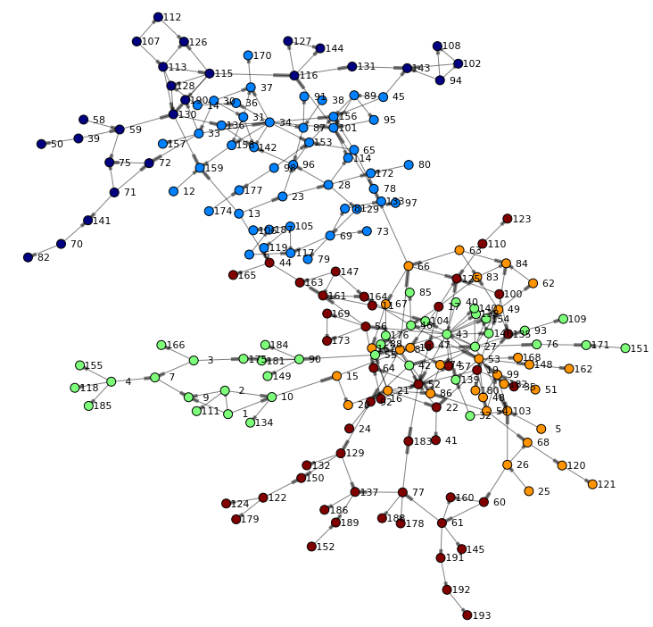
Discovering communication patterns
The structural information of emails (to, from, cc fields) can be presented as a network of communication between persons.
In this network nodes (vertices) represent persons and links between the nodes (arcs) represent emails.
A subset of nodes corresponds to the set of custodians.

Slide 8
Social Network Analysis (SNA)
SNA is the mapping and measuring of relationships and flows between people, groups, organizations, computers, web sites, and other information/knowledge processing entities.
SNA defines a number of centrality measures to objectively evaluate the role of persons in the network (Scott, 1991).
The three most popular centrality measures are degree, closeness and betweenness.

Slide 9
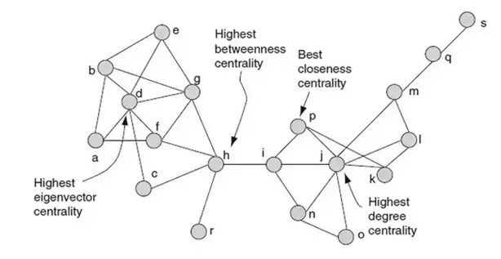
Degree, closeness and betweenness
These measures of centrality give objective criteria that can be used to evaluate the structure of the email collection and to determine if certain parts of the collection can be discarded or if the collection is insufficient.

Slide 10
Degree centrality
Degree centrality is simply calculated as the number of links to or from a person.
In E-Discovery custodians typically have a high degree of centrality because the data was collected from their mailboxes.
In SNA there are different interpretations for nodes with a high degree of centrality.
A node can be a “hub”, “authority” (or both) and also brokerage roles are distinguished identifying if a node is a coordinator, liaison etc. (Batagelj and Mrvar, 2003).
If there is an important node in the email network that is not a custodian, it may be interesting to investigate why the person corresponding to that node is not a custodian.

Slide 11
Closeness centrality
Closeness centrality is the average number of links it takes a person to reach any other person in the network.
Persons that have the lowest closeness are considered to be close to everyone in the network.
They could be important persons with many direct connections to other persons in the network.

Slide 12
Betweenness centrality
Betweenness centrality measures how many times a person is in the shortest path between any two other persons in the network.
Persons with a high degree of betweenness can be important because they have a ‘liaison’ role between different networks.
Such persons may have access to multiple networks and have valuable other information or access to other unknown networks.

Slide 13
Eigenvector centrality
Eigenvector centrality takes into account the importance of neighboring persons when calculating the centrality of a person.
You could say it is a weighted (i.e. more sophisticated) version of degree centrality.
This resembles closely how the importance of web pages can be rated based on the ratings of pages that refer to it. See for instance:
the well-known PageRank algorithm used by Google (Brin and Page, 1998) and
the algorithm suggested by Kleinberg (1999) to find authoritative sources in a hyperlinked environment.

Slide 14
Resolving aliases
Resolving aliases is an important step in reducing the complexity of the network and increasing review consistency.
Custodians may use more than one email address to communicate (aliases). The specific email pattern of a user can also reveal aliases of a user.
This might be intentionally to hide another identity but more often this is due to a change of email server or the use of different email address formats, e.g., internal versus external address format.
Centrality measures may assist in flagging different email addresses that potentially belong to the same person.

Slide 15
SNA with keyword and time filtering
Perform SNA on cross sections of the email collection by using keyword filtering combined with date-time intervals.
By analyzing the email network in different time slices, the centrality measures mentioned above can be compared over time.
Keyword filtering can restrict the email network to certain topics to study the effect this has on the role of different persons:
a person may be a hub on a specific topic while he or she has a more standard role on another topic.
Keyword and time filtering can decompose a complicated network in underlying smaller and less complicated topic-based networks

Slide 16
Investigating case specific events
Case specific events are, for example:
the merger of two companies or
the negotiation of a commercial contract,
Combining a time window with a full-text filter can be helpful to discover which persons have received emails that are related to the event.
Once such a network is identified, the date time range may be widened to discover other topics that are discussed within this particular network.

Slide 17
Experiment with the Enron email dataset
We have conducted a number of experiments using the Enron email collection (Klimt and Yang, 2004)
The 400Mb (compressed, without attachments) dataset contains 517,431 emails belonging to 150 custodians that were made public during the legal investigation concerning the Enron Corporation.
This email set was deduplicated across all custodians resulting in 252,956 emails.

Slide 18
Representing the Enron email dataset
M: Enron email set is a table with messages M:
Table Messages M = (E, D) where E is message id and D is number of days between email sent date and 1/1/1997
R: The table Relations R stores a relation for each email and address combination.
This relation has a field O which denotes if an address was in the „From‟, „To‟ or „Cc‟ field.
This results in a total of 1,635,833 email, address, type (E,A,O) relations for the full collection.
C: Table Custodians C stores one or more addresses A for a custodian C

Slide 19
What are Custodians?
A custodian is defined as a person that is the owner of an email archive on a desktop computer or fileserver or of an mailbox on a server that has been collected as part of E-Discovery.
Table C was constructed by identifying for each custodian C one or more (unique) email addresses A by examining the ‘From’ field for emails in the ‘Sent Items’ folder.

Slide 20
Email (heat)Map
Using a SQL-query a list of a little over 50,000 triplets was constructed containing Custodian, Day and the number of emails where a Custodian is either in the „From‟, „To‟ or „Cc‟ field on that particular day. This can be formalized as follows:
Table Map M = (X, Y, Count)
Select C as X, D as Y, Count( Messages ) From Emails
Inner Join Relations on Relations.E = Emails.E
Inner Join Custodians on Custodians.A = Emails.A
Group by C, D
The resulting data set is an array M(X,Y) where X = Custodian and Y = Day denoting the position of a painted rectangle with a gray value based on the corresponding Count value.

Slide 21
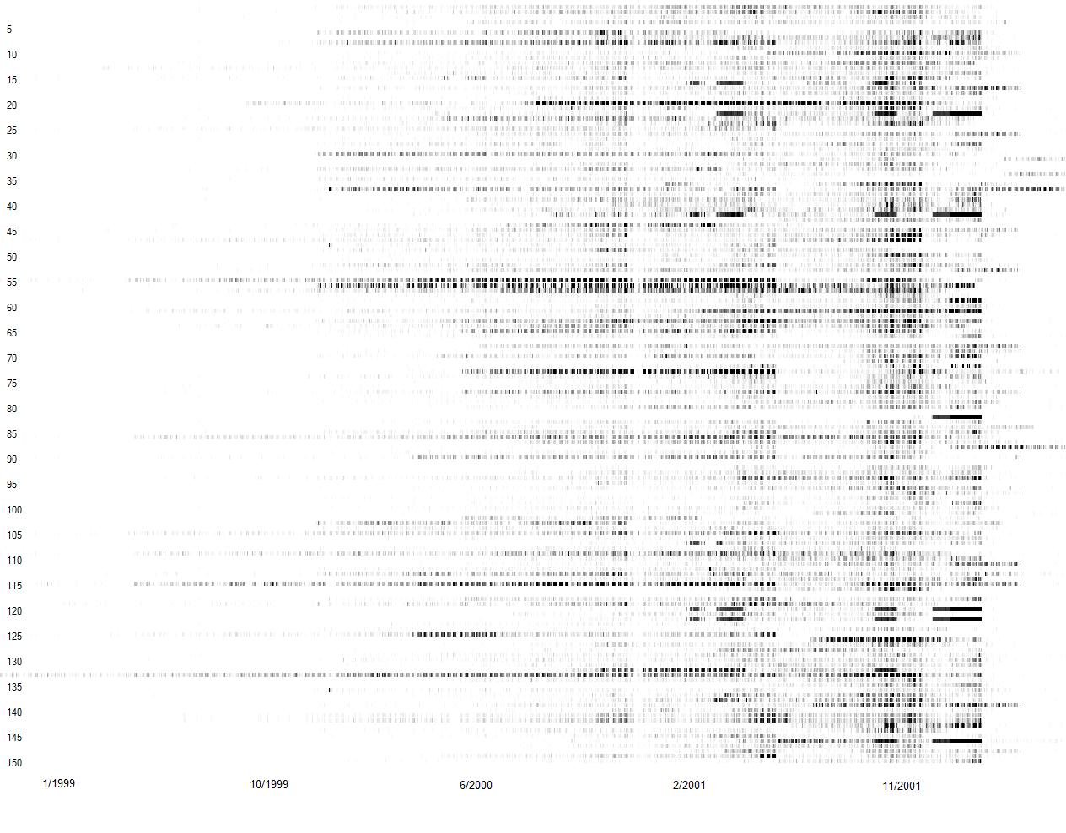
Visualisation of the Email map

Slide 22
Observations from the Email map
Email traffic differs per custodian both in start date as well as intensity.
Small modulations are visible indicating that typically less emails are sent and received during the weekends.
Larger modulations reflect season characteristics (e.g. summer holiday)
Interesting similarities:
Custodians 22, 42, 82, 120, 122 and 146 show very intense email traffic starting after November 2001
These custodians are involved in trading and the final email burst starts around or shortly after the date Enron has filed for bankruptcy on December 2nd, 2001

Slide 23
Email map keyword filtering
We can calculate an email map for parts of the email collection by filtering on a particular search term.
A search term is represented by a query Q and the message id’s E of the messages that are responsive to this query are represented in a table Hits H as follows:
Table Hits H = ( E, Q ) where E is message id and Q is query to which message E is responsive
The search term fingerprint MQ associated with query Q is an email map representing only messages E that are in H(E,Q). We add a 3rd inner join to the Email map query:
Inner Join Hits on Hits.Q = Q
Where Emails.E = Hits.E

Slide 24
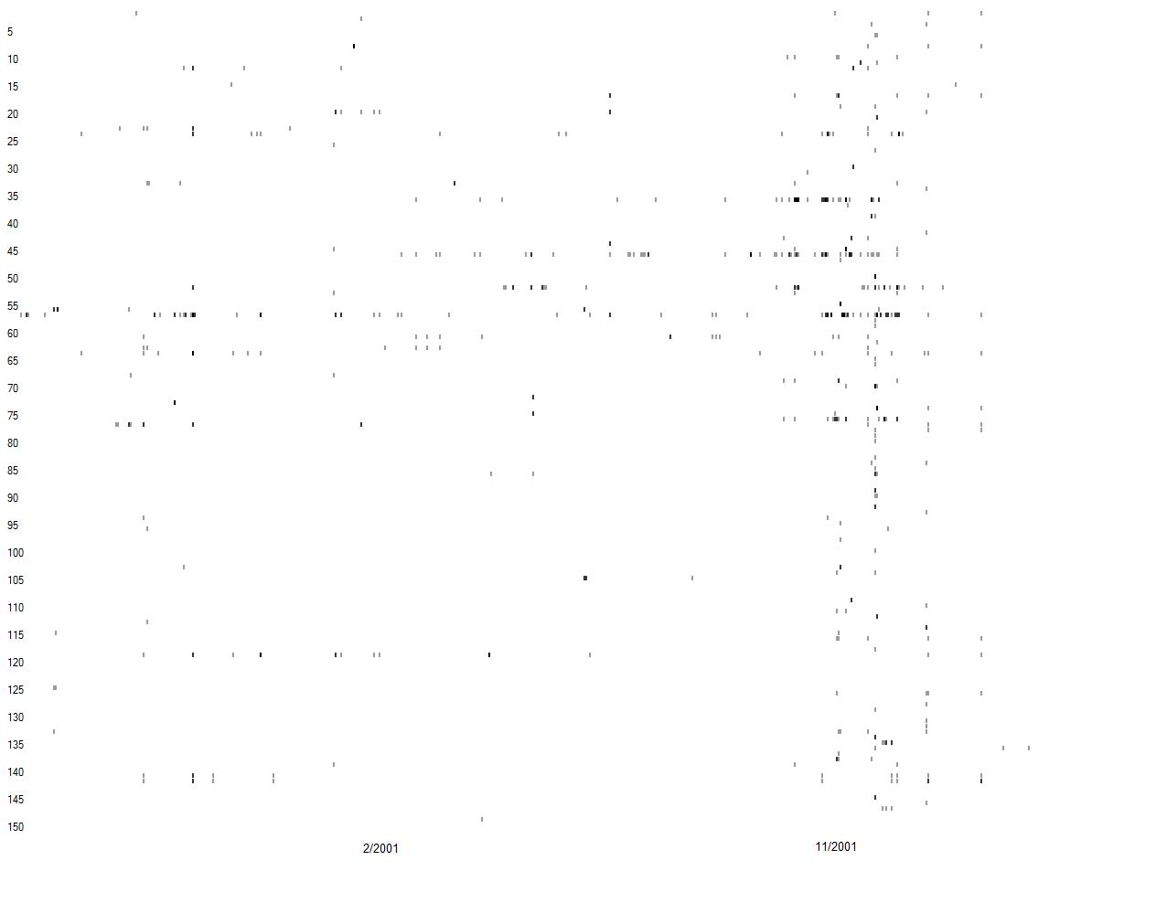
Email map after filtering on ”Azurix”
Email map based on all emails that are responsive to the query “Azurix OR (Wessex Water)”.
This query was selected because Wessex Water in the UK was acquired by Enron in 1999 and would form the basis for its water subsidiary Azurix.
In total 782 emails respond to this query.

Slide 25
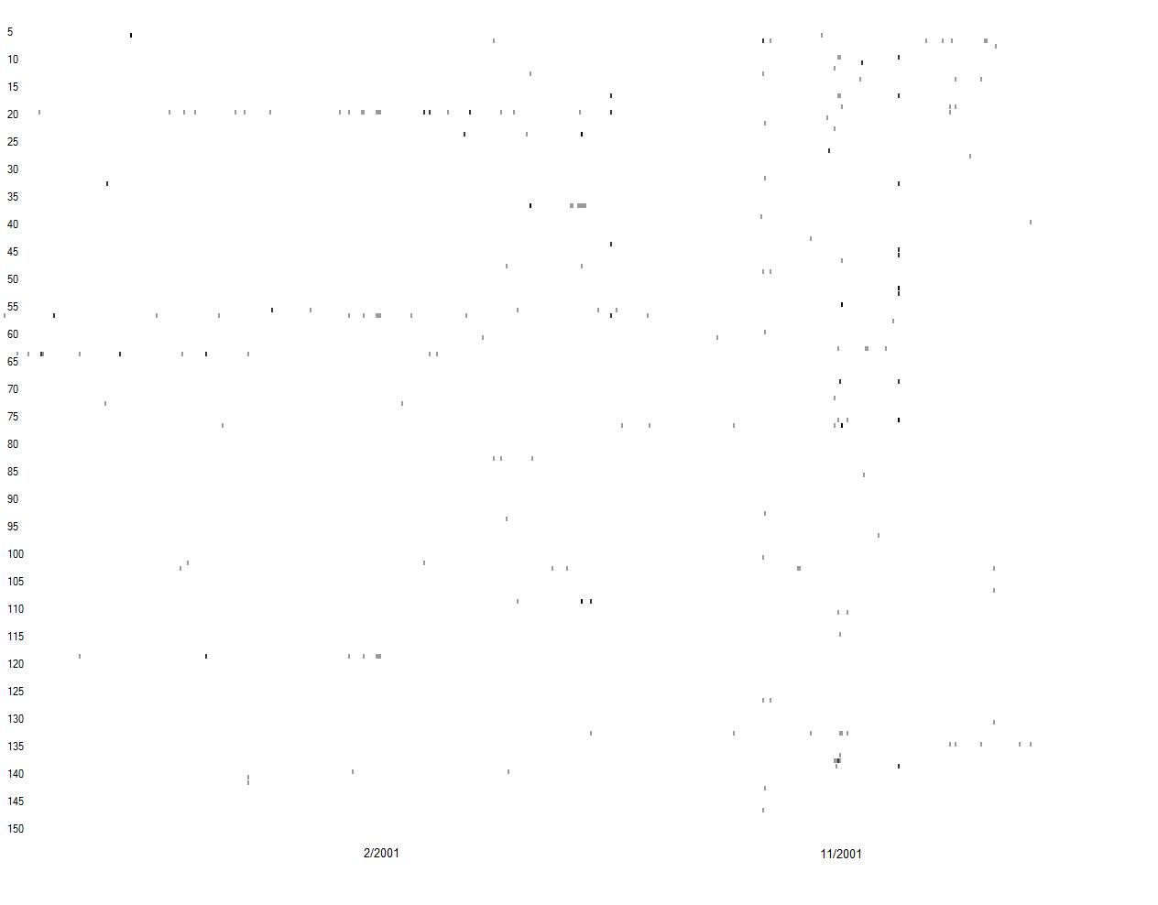
Email map after filtering on ”Blockbuster”
Email map based on all emails that are responsive to the query “Blockbuster”.
This query was selected because in 2000 Enron and Blockbuster announced an important strategic alliance that is called off in March 2001.
In total 330 emails respond to this query.

Slide 26
Search timeline
The search term fingerprints show small details because the report hits per custodian per day’.
Sum the hits across all custodians and examine the variation over time for spikes that are related to specific events.
We call this the timeline T(D,Count) which represents the number of messages on day D:
Table timeline TQ = (X,Count) for query Q
Select D as X, Count( Messages ) From Emails
Inner Join Relations on Relations.E = Emails.E
Inner Join Hits on Hits.Q = Q
Where Emails.E = Hits.E
Group by D

Slide 27
Search timeline with relative hit density
Problem: total number of emails per day varies so that the absolute number of emails responsive to Q on day D1 can’t be compared to another day D2
In stead we represent the number of hits for a query on day D as the percentage of the total number of emails over that same period:
D = 100% x TQ.Count / T.Count

Slide 28
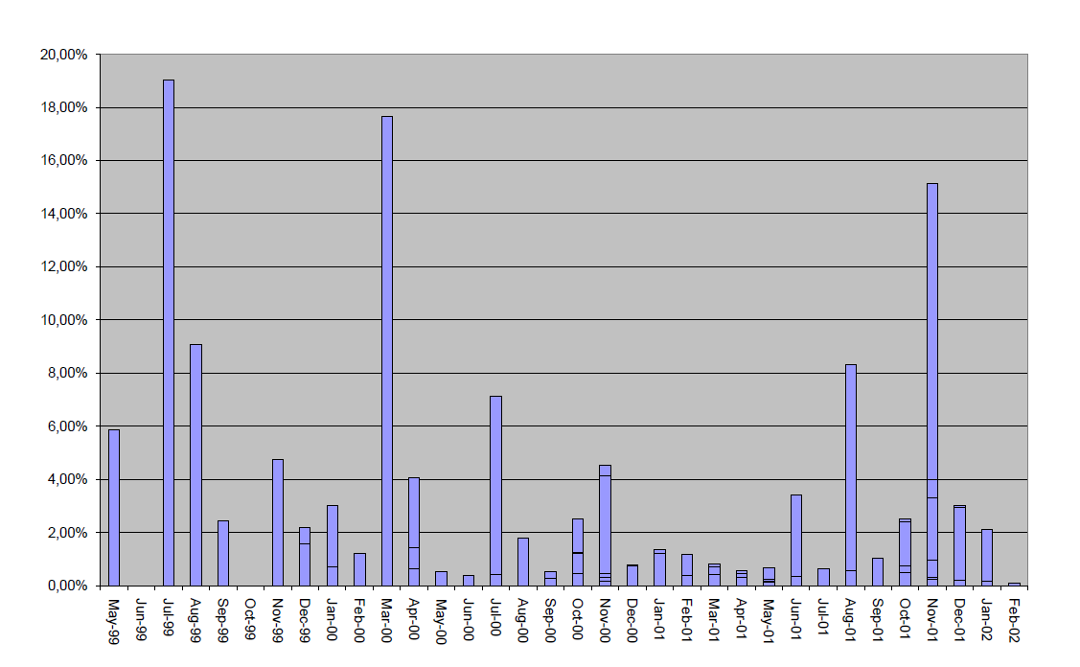
Search timeline for “Azurix”
Azurix did an IPO in Spring 1999.
However, early 2001 problems arose and Azurix had to sell bonds below their investment grade.
This did not help and in August 2001 the CEO of Enron International had to retire from Azurix.

Slide 29
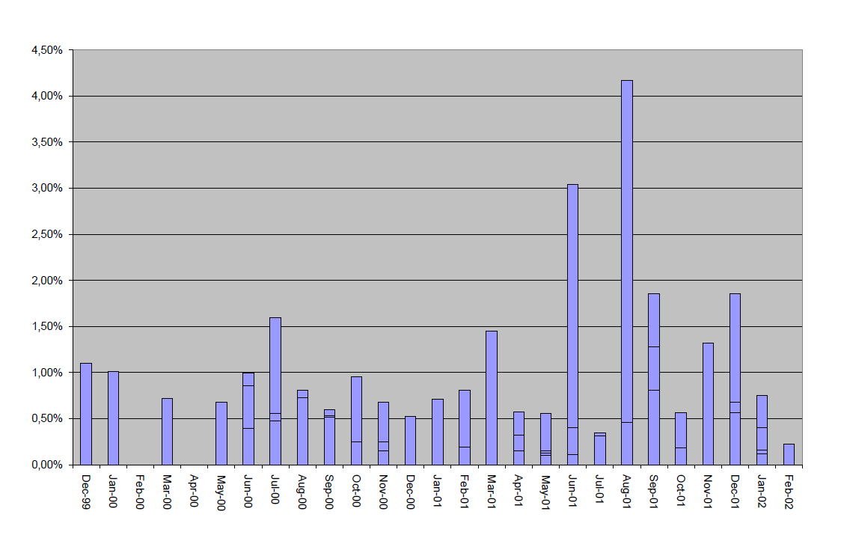
Search timeline for “Blockbuster”
In July 2000 Enron announced a deal with Blockbuster but in March 2001 the companies ended this venture.
In August 2001 Enron CEO Jeff Skilling resigned and there were speculations around the Blockbuster.

Slide 30
Search term SNA
The email maps give a global overview of email activity that can be fine tuned by filtering on keywords.
This is a simple solution to discover more about the email collection but it lacks a great deal of information that is also available in the email headers.
A search term social network can be an effective procedure for investigating the social networks that are present in the email collection.

Slide 31
Performing search term SNA for emails
The „Blockbuster‟ query (Q) resulted in 330 responsive emails. A network for this collection can be constructed as follows:
For each responsive email, create pairs of email addresses always starting with the „From‟ address and ending with an address from the „To‟ and „Cc‟ fields.
These edges form a directed graph that is stored in table LQ
For the „Blockbuster‟ query this results in:
1,090 directed edges, also known as arcs, with 747 unique email addresses which are interpreted as vertices in the network.
These vertices are stored in a table VQ

Slide 32
Construction of VQ and LQ
VQ:
Table vertices VQ = ( Vx ) for query Q
Select distinct A as Vx From Relations
Inner Join Hits On Hits.E = Relations.E
Where Hits.Q = Q
LQ:
Table edges LQ = (Va, Vb, Count)
Select Relations.A as Va, Relations_1.A as Vb, Count ( Relations )
From (Relations Inner Join Hits on Relations.E = Hits.E)
Inner Join Relations As Relations_1 on Relations.E = Relations_1.E
Where((Relations.O = „From‟ And (Relations_1.O<>„From‟))
And (Hits.Q = Q))
Group by Relations.A, Relations_1.A

Slide 33
Calculating centrality measures
The 2010 paper explains how SNA centrality measures can be calculated
In our case it may make more sense to load VQ and LQ in a network analysis package that can be used for calculating these measures and for visualisations.
We’ll use a the Python networkx package

Slide 34
10:00-10:15

Slide 35
Exercise 7: Plot emails on a timeline and visualize email network

Slide 36
Exercise timings
20 minutes per exercise (app) and 5 minutes recap
10:40 recap exercise 1
10:55 recap exercise 2 & 3
11:15 recap exercise 4
11:35 recap exercise 5
11:55 recap exercise 6 & 7

Slide 37
12:00-13:00

Slide 38
Part 8: Advanced Full-text search strategies

Slide 39
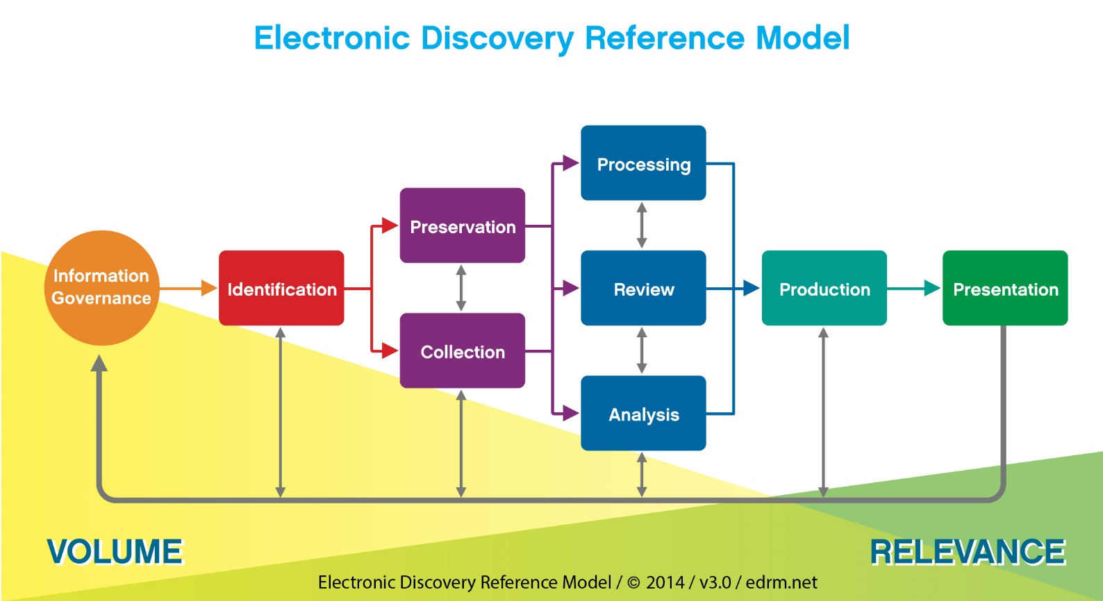
Full-text search in E-Discovery
Notes:
Vandaag ligt de nadruk op review & analyze. Review is een proces waarbij één of meerdere onderzoekers een verzameling geselecteerde emails en documenten doorlezen en beoordelen op relevantie. analyze is het proces waarbij verbanden worden gelegd en de inhoud van de relevant bestanden wordt geinterpreteerd in de context van het onderzoek. Bijvoorbeeld om een bepaalde onderzoeksvraag te beantwoorden. analyze kan ook aanleiding geven tot bijstelling van de indentificatie zodat mogelijk meer data verzameld moet worden.

Slide 40
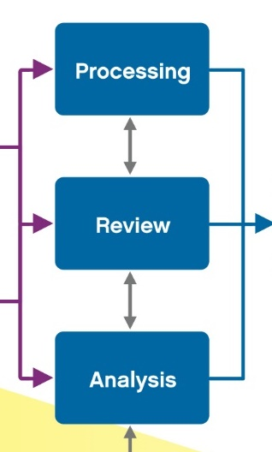
Processing, Review & Analysis
Processing:
typically culling data = Automated filtering based on meta data (e.g. date filtering, based on extension, NIST filtering, deduplication and sometimes keyword/query based).
Review & Analysis:
manually searching for data by formulating queries and looking for interesting relationships.
In E-Discovery it’s important that you have a reasonable process that you can explain and justify in court.
Formulating processing and reviewing criteria is important.
Notes:
Voor het zoeken in informatie wordt gebruik gemaakt van zoektermen. Deze worden gecombineerd met filters op de meta data (bijvoorbeeld afzender, datum enz) om te trechteren.

Slide 41
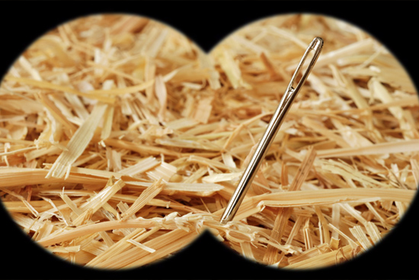
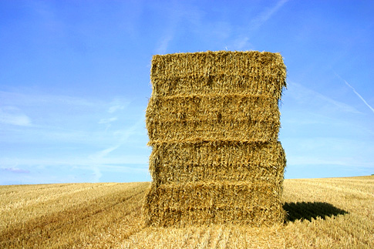
About Digital Experts and Investigators
Notes:
Zoeken naar een speld in een hooiberg. Maar welke hooiberg? En hoe ziet die speld eruit?

Slide 42

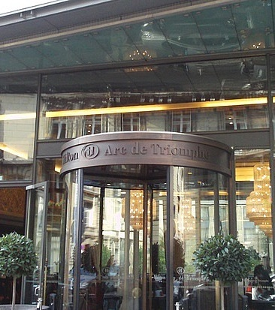
Paris Hilton?
Notes:
Stel je zoekt naar Paris hilton. Ben je dan op zoek naar de celebrity paris hilton of het hilton hotel in parijs? Zoeken op trefwoorden is niet zaligmakend. Welke zoekwoorden moet je gebruiken?

Slide 43
The problem in investigations
Problem:
“investigator doesn’t know what to look for precisely”
Examples:
Due diligence in mergers and acquisitions: search for the unknown
Legal proceedings
Regulatory investigations
Digital forensic investigations !
It’s different from just Google search:
We need to find all relevant data and aim for TOTAL RECALL
Consequently:
Investigator has to evaluate relevance of search results
Notes:
Het grote probleem is dat een fraude onderzoekers niet precies weet waar je precies naar op zoek bent. Denk aan de oefeningen van deze ochtend.

Slide 44
Recall and Precision
S: All Documents
A: Documents we are looking for
B: Documents that are retrieved
True Positive TP = |B ∩ A|
False Positive FP = |B – TP|
False Negative FN = |A – TP|
True Negative TN = |S – A – B|
(A = |A|, B = |B|, S = |S| )
S
B
A
Notes:
Dit is een slide met annimatie die visualizeert wat recall en precisie betekenen.

Slide 45
Ideal situation
100% recall
100% precision
A = B = TP
FP = FN = 0
R = TP / (TP + FN) = 1
P = TP / (TP + FP) = 1
S
B
A
Notes:
Ideale geval wanneer we exact alles vinden wat er te vinden valt. Recall en precisie zijn dan allebeid 100% (1)

Slide 46
Worst case
0% recall
0% precision
TP = 0
R = TP / (TP + FN) = 0
P = TP / (TP + FP) = 0
S
B
A
Notes:
In het slechtste geval vind je helamaal niets. Dan is de recall 0 en de precisie is ook 0.

Slide 47
Great precision but poor recall
100% precision
Incomplete results (recall < 50%)
Missing evidence
FP = 0
Assume FN > TP
R = TP / (TP + FN) < 0.5
P = TP / (TP + FP) = TP/TP = 1
S
A
B
Notes:
In werkelijkheid zal het resultaat er altijd tussen in liggen. Naarmate je probeert de recall te verhogen zal het resultaat waarschijnlijk minder precies worden. Het gevolg van een lage precisie is dat je veel extra werk hebt aan het doorlezen van niet relevante documenten en emails.

Slide 48
Retrieve all A but with poor precision
100% recall
Not very precise (precision < 50%)
Many results off topic
A lot of extra work
Assume FP > TP
FN = 0
R = TP / (TP + FN) = 1
P = TP / (TP + FP) < 0.5
S
B
A
Notes:
In werkelijkheid zal het resultaat er altijd tussen in liggen. Naarmate je probeert de recall te verhogen zal het resultaat waarschijnlijk minder precies worden. Het gevolg van een lage precisie is dat je veel extra werk hebt aan het doorlezen van niet relevante documenten en emails.

Slide 49
Accuracy and F-Measure
Accuracy A is the percentage positieve and negative resultats
A = (TP + TN) / S
The F-measure F is combines Precision and Recall (harmonic mean):
F = 2(P*R)/(P+R)

Slide 50
Accuracy vs F-Measure
Accuracy A | F-Measure
100% | 100%
< 100% but also > 0% | 0%
< 100% | < 100%
S
A
B
S
B
A
S
B
A

Slide 51
Searching in unstructured data
Boolean (phrase) search:
Simple relevant ranking information on hit density and key word highlighting (with context)
Predictable but not very distinctive
Boolean (phrase) search with proximity:
Increase precision by searching for words in context
Vector-space based search.
Strong multi-dimensional relevance ranking but neither proximity nor hit highlighting
Notes:
Booleaans zoeken is het meest bekend. Verschillende zoekwoorden kunne gecom

Slide 52
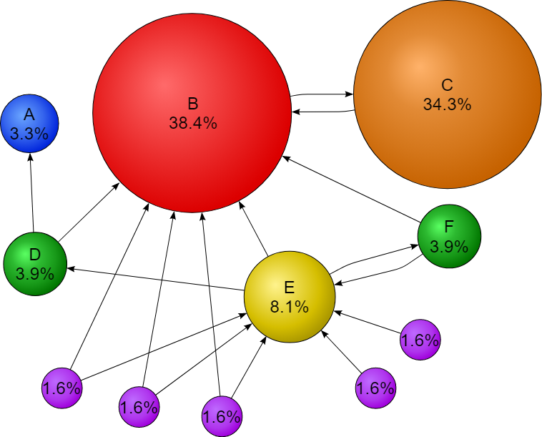
Recall & Precision
In Google-search ranks results based on Page Rank
In digital forensic investigations we do not have such a ranking method.
The problem is:
Digital investigations require high recall, but …
… when increasing recall the precision gets worse.

Slide 53
Search strategy
Step 1: Increase Recall
With the help of full-text retrieval
Step 2: Increase precision
Can we improve search queries?
So that we get better results
Without impacting precision?
Step 3: Deal with low precision
Solutions to quickly evaluate results.
Notes:
Zoeken vergt ervaring en handig zoeken kan nog al verschillen per tool. We zullen hier een simpele strategie uitleggen die meestal geschikt is al uitgangspunt. Stap 1 is het verhogen van de recall. Het uitbreiden van de zoekvraag om ervoor te zorgen dat je geen relevante hits mist. Het nadeel van deze stap is dat de precisie omlaag gaat. Daarom is stap 2 gericht op het verhogen van de precisies. Hoe kan de zoekvraag verfijnd worden zoals we minder false positives krijgen. Tenslotte is het nog handig om stap 3 te ontwikkelen. Dat is ene strategie om beter om te gaan met lage precisie.

Slide 54
Search strategy
Step 1: Increase Recall
With the help of full-text retrieval
Step 2: Increase precision
Can we improve search queries?
So that we get better results
Without impacting precision?
Step 3: Deal with low precision
Solutions to quickly evaluate results.
Notes:
Zoeken vergt ervaring en handig zoeken kan nog al verschillen per tool. We zullen hier een simpele strategie uitleggen die meestal geschikt is al uitgangspunt. Stap 1 is het verhogen van de recall. Het uitbreiden van de zoekvraag om ervoor te zorgen dat je geen relevante hits mist. Het nadeel van deze stap is dat de precisie omlaag gaat. Daarom is stap 2 gericht op het verhogen van de precisies. Hoe kan de zoekvraag verfijnd worden zoals we minder false positives krijgen. Tenslotte is het nog handig om stap 3 te ontwikkelen. Dat is ene strategie om beter om te gaan met lage precisie.

Slide 55
Increase recall: OR, Wild Cards and Fuzzy
OR search:
Combine different terms with OR. All documents containing one or more terms are retrieved.
Standard wildcard search:
Searching for “Hen*” finds all documents containing words starting with “Hen”
Fuzzy degree:
Fuzzy=1: Word should match with any word that has zero or one character change (change, insertion or deletion) from the orignal
Notes:
Met OR kunnen je meerdere woorden tegelijkertijd combineren in één zoekvraag. Documenten met tenminste één van deze woorden zullen worden gevonden. De quorum search wordt door ZyLAB ondersteund. Kan soms handig zijn als je een set van woorden hebt en er moeten tenminste een aantal (2 of meer) voorkomen in een document dat je wil vinden.

Slide 56
Fuzzy and Levenshtein distance
The Levenshtein distance between two strings is defined as the minimum number of edits needed to transform one string into the other,
with the allowable edit operations being insertion, deletion, or substitution of a single character.
Example :
Distance 1: kitten → sitten (substitution of 's' for 'k’)
Distance 2: sitten → sitting (substitution of 'i' for ‘e’, insertion of 'g' at the end).
Also see http://en.wikipedia.org/wiki/Levenshtein_distance

Slide 57
Search strategy
Step 1: Increase Recall
With the help of full-text retrieval
Step 2: Increase precision
Can we improve search queries?
So that we get better results
Without impacting precision?
Step 3: Deal with low precision
Solutions to quickly evaluate results.
Notes:
Zoeken vergt ervaring en handig zoeken kan nog al verschillen per tool. We zullen hier een simpele strategie uitleggen die meestal geschikt is al uitgangspunt. Stap 1 is het verhogen van de recall. Het uitbreiden van de zoekvraag om ervoor te zorgen dat je geen relevante hits mist. Het nadeel van deze stap is dat de precisie omlaag gaat. Daarom is stap 2 gericht op het verhogen van de precisies. Hoe kan de zoekvraag verfijnd worden zoals we minder false positives krijgen. Tenslotte is het nog handig om stap 3 te ontwikkelen. Dat is ene strategie om beter om te gaan met lage precisie.

Slide 58
Increase precision: AND and NOT
AND search:
Search for documents containing multiple words:
Example: Lay AND Skilling
AND NOT search:
Eclude documents when a certain word occurs:
Example: blackout AND NOT mentions
Notes:
Door met AND woorden te comineren kunnen je preciezer zoeken. Door NOT te gebruiken kun je resultaten wegfilteren die niet interessant zijn. Bijvoorbeeld "blackout AND NOT (enron mentions)". Je kunt ook phrases zoeken. Dat wil zeggen dat je zoekt naar woorden precies in de volgorde waarin ze in de zoekvraag worden ingetypt.

Slide 59
Increase precision: Phrase and Proximity
Phrase search:
“green car” searches for the exact phrase where the “car” immediately follows “green”.
Proximity search:
“green w/10 car” searches for the words “green” and “car” within 10 words distance
“green p/10 car” searches for the word “car” which is preceeded by the word “green” by max 10 words
Context search:
“EOP to EOP {green AND car}” searches for paragraphs which contain both “green” and “car.
Notes:
Door met AND woorden te comineren kunnen je preciezer zoeken. Door NOT te gebruiken kun je resultaten wegfilteren die niet interessant zijn. Bijvoorbeeld "blackout AND NOT (enron mentions)". Je kunt ook phrases zoeken. Dat wil zeggen dat je zoekt naar woorden precies in de volgorde waarin ze in de zoekvraag worden ingetypt.

Slide 60
Increase precision using meta data
Restrict search to subject of an email or title of a document.
Restrict search to specific period:
Send date > 1-1-2000 AND Send date < 1-1-2001
Document type
Only PDF or MsWord documents
Only JPG
Specific sender:
Searc in emails met From = K. Lay

Slide 61
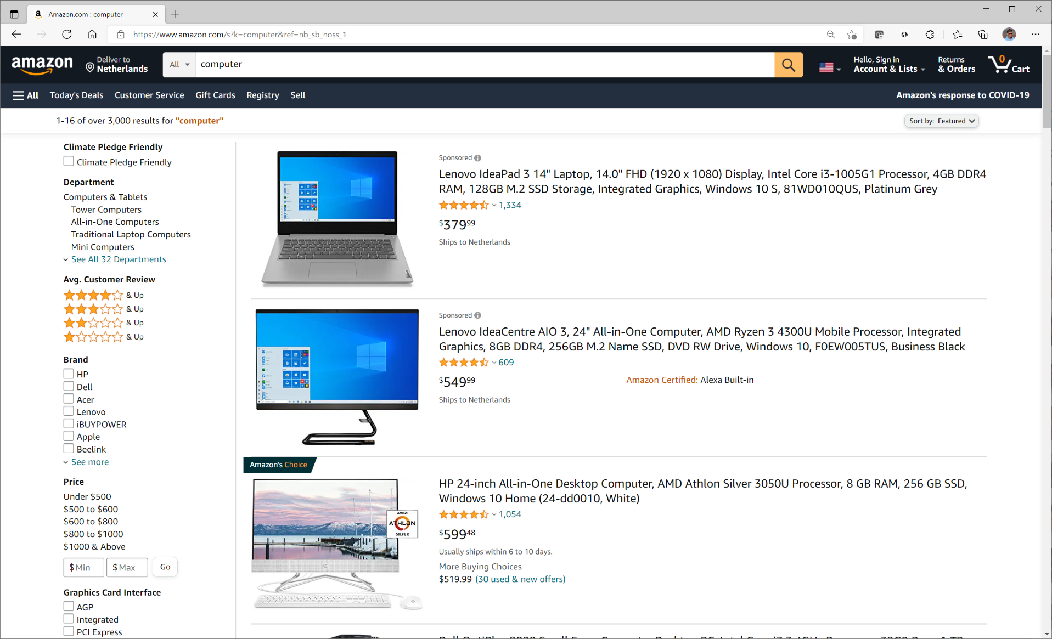
Increase precision with meta data (2)

Slide 62
Search strategy
Step 1: Increase Recall
With the help of full-text retrieval
Step 2: Increase precision
Can we improve search queries?
So that we get better results
Without impacting precision?
Step 3: Deal with low precision
Solutions to quickly evaluate results.
Notes:
Zoeken vergt ervaring en handig zoeken kan nog al verschillen per tool. We zullen hier een simpele strategie uitleggen die meestal geschikt is al uitgangspunt. Stap 1 is het verhogen van de recall. Het uitbreiden van de zoekvraag om ervoor te zorgen dat je geen relevante hits mist. Het nadeel van deze stap is dat de precisie omlaag gaat. Daarom is stap 2 gericht op het verhogen van de precisies. Hoe kan de zoekvraag verfijnd worden zoals we minder false positives krijgen. Tenslotte is het nog handig om stap 3 te ontwikkelen. Dat is ene strategie om beter om te gaan met lage precisie.

Slide 63
Dealing with low precision
Improve navigation for the user:
Fast navigation
Hit highlighting
Keywords in context
Relevance ranking
Based on term frequency in the index
Document clustering

Slide 64
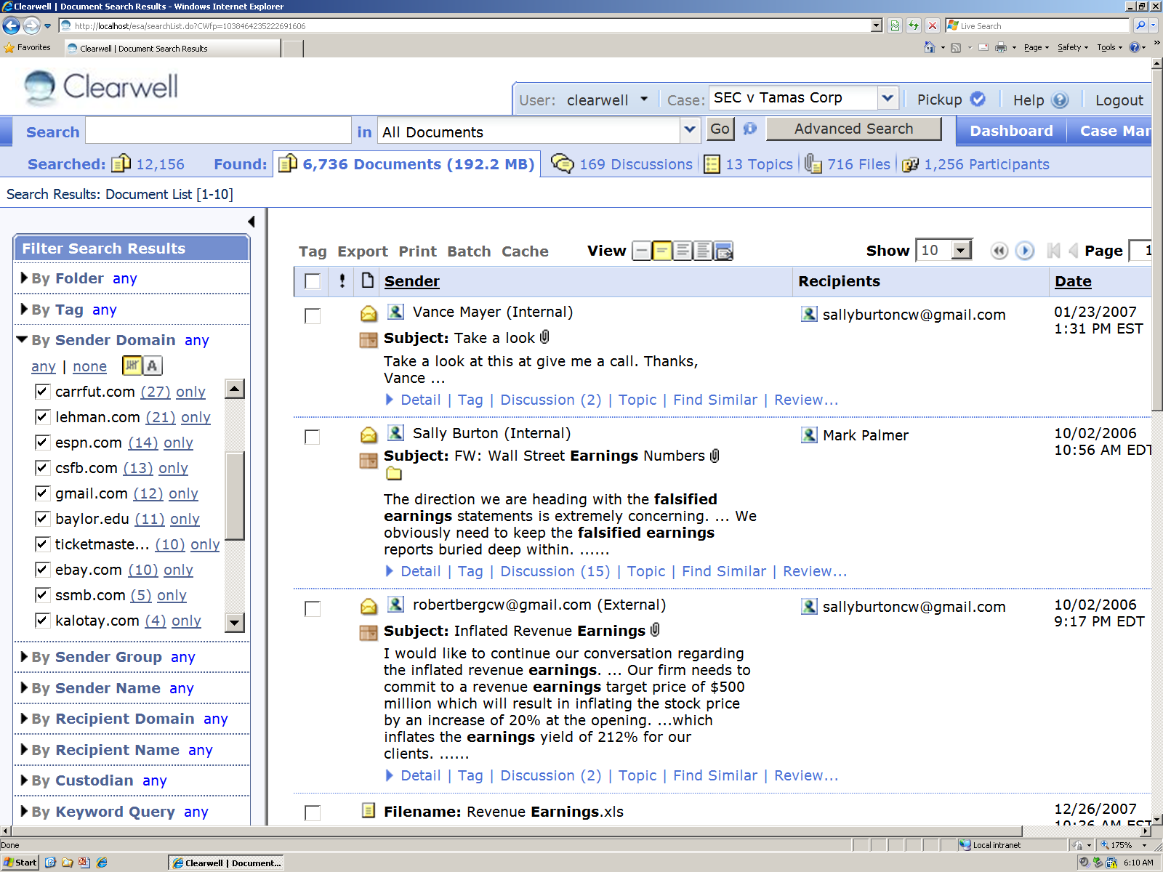
Keywords in context and drill down

Slide 65
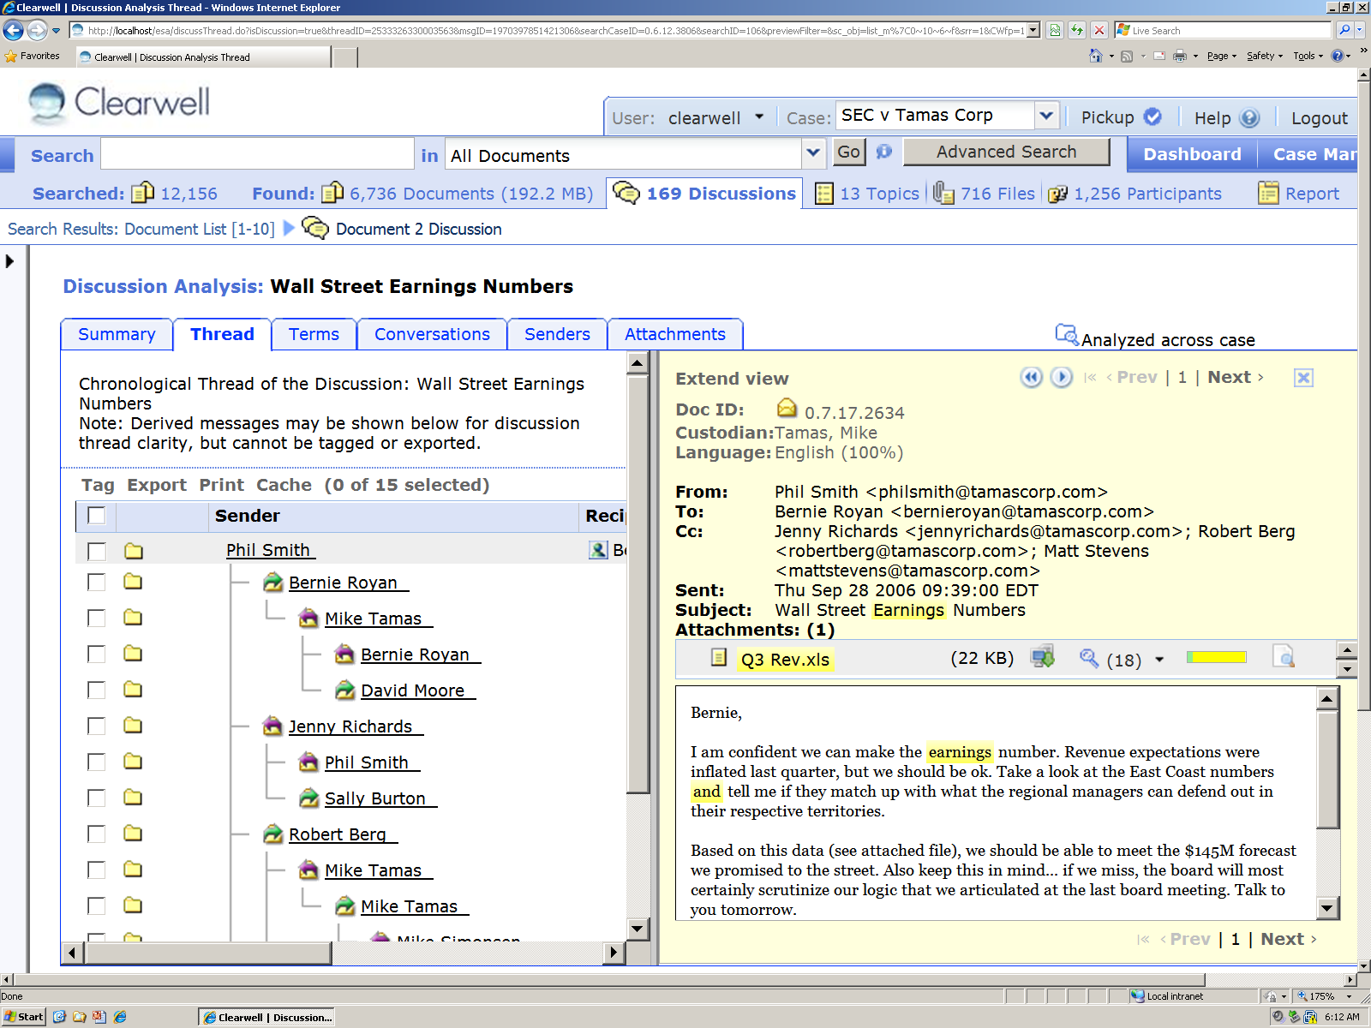
Email threading

Slide 66
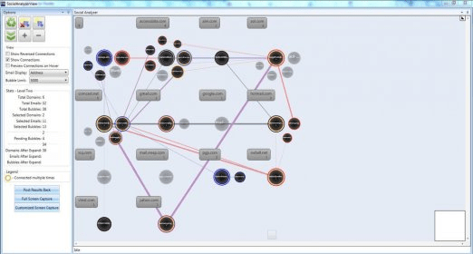
Browsing quick through results
Timeline
Social Network analyzer
Heatmap
Geolocation

Slide 67
Day 4: What have you learned?
Filtering and visualizing email data
Use a heatmap to visualize email traffic density
Basics of social network (relationship) analysis
visualizing a graph network in Python
Full-text search strategies
Combining full-text search with facet search
Understand recall and precision

Slide 68
14:00-14:15

Slide 69
Student project part 2/2: finish your project

Slide 70
Student projects schedule: part 2/2
Day 3 14:30-16:00 start of your project
Day 3 16:00-16:20 2 minute pitch of your project idea
Day 4 14:00-16:30 continue working on your project
Day 5 13:00-15:00 9x 10 minute presentations
Day 5 15:00-15:30 break
Day 5 15:30-16:30 grading and evaluation
Grades will be based on 3 elements in the presentation
Reflection of what you have learned this week
Data analytics part (loading, cleaning and tranforming data)
Data visualisation part

Slide 73
Contact information
Dr.ir. Hans Henseler
henseler.h@hsleiden.nl

